Slide 1

Image segmentation
Prepared by:
Lim Jia Qi

Slide 2
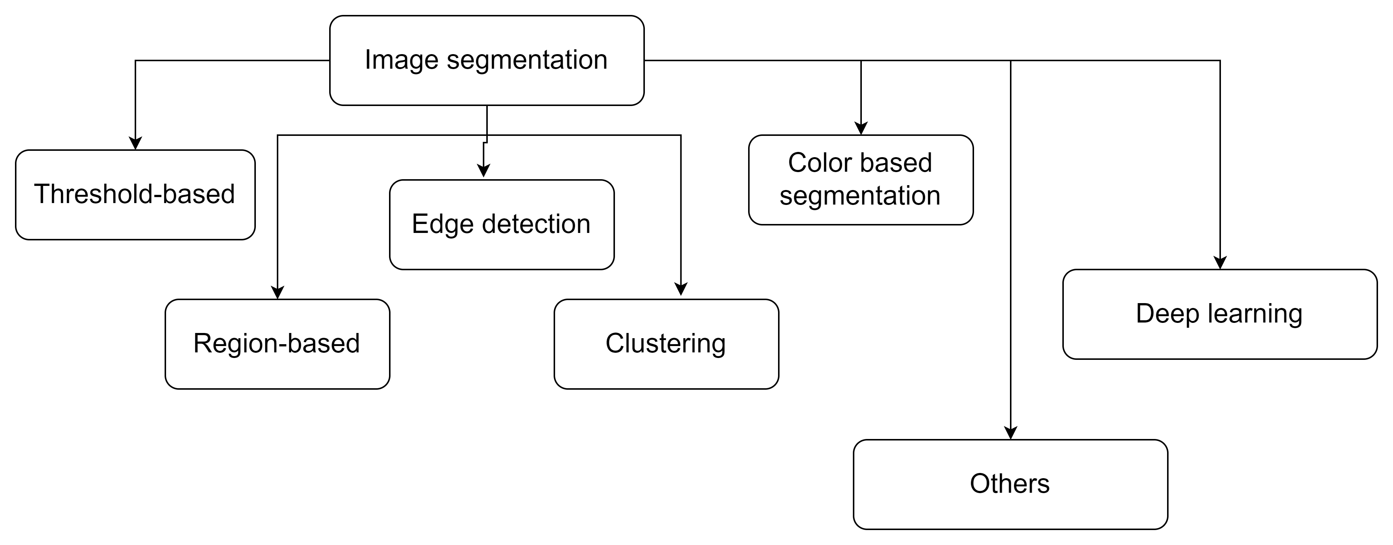
Definition
Image segmentation is the operation of partitioning an image into a collection of connected sets of pixels.

Slide 3

IOU Computation

Slide 4
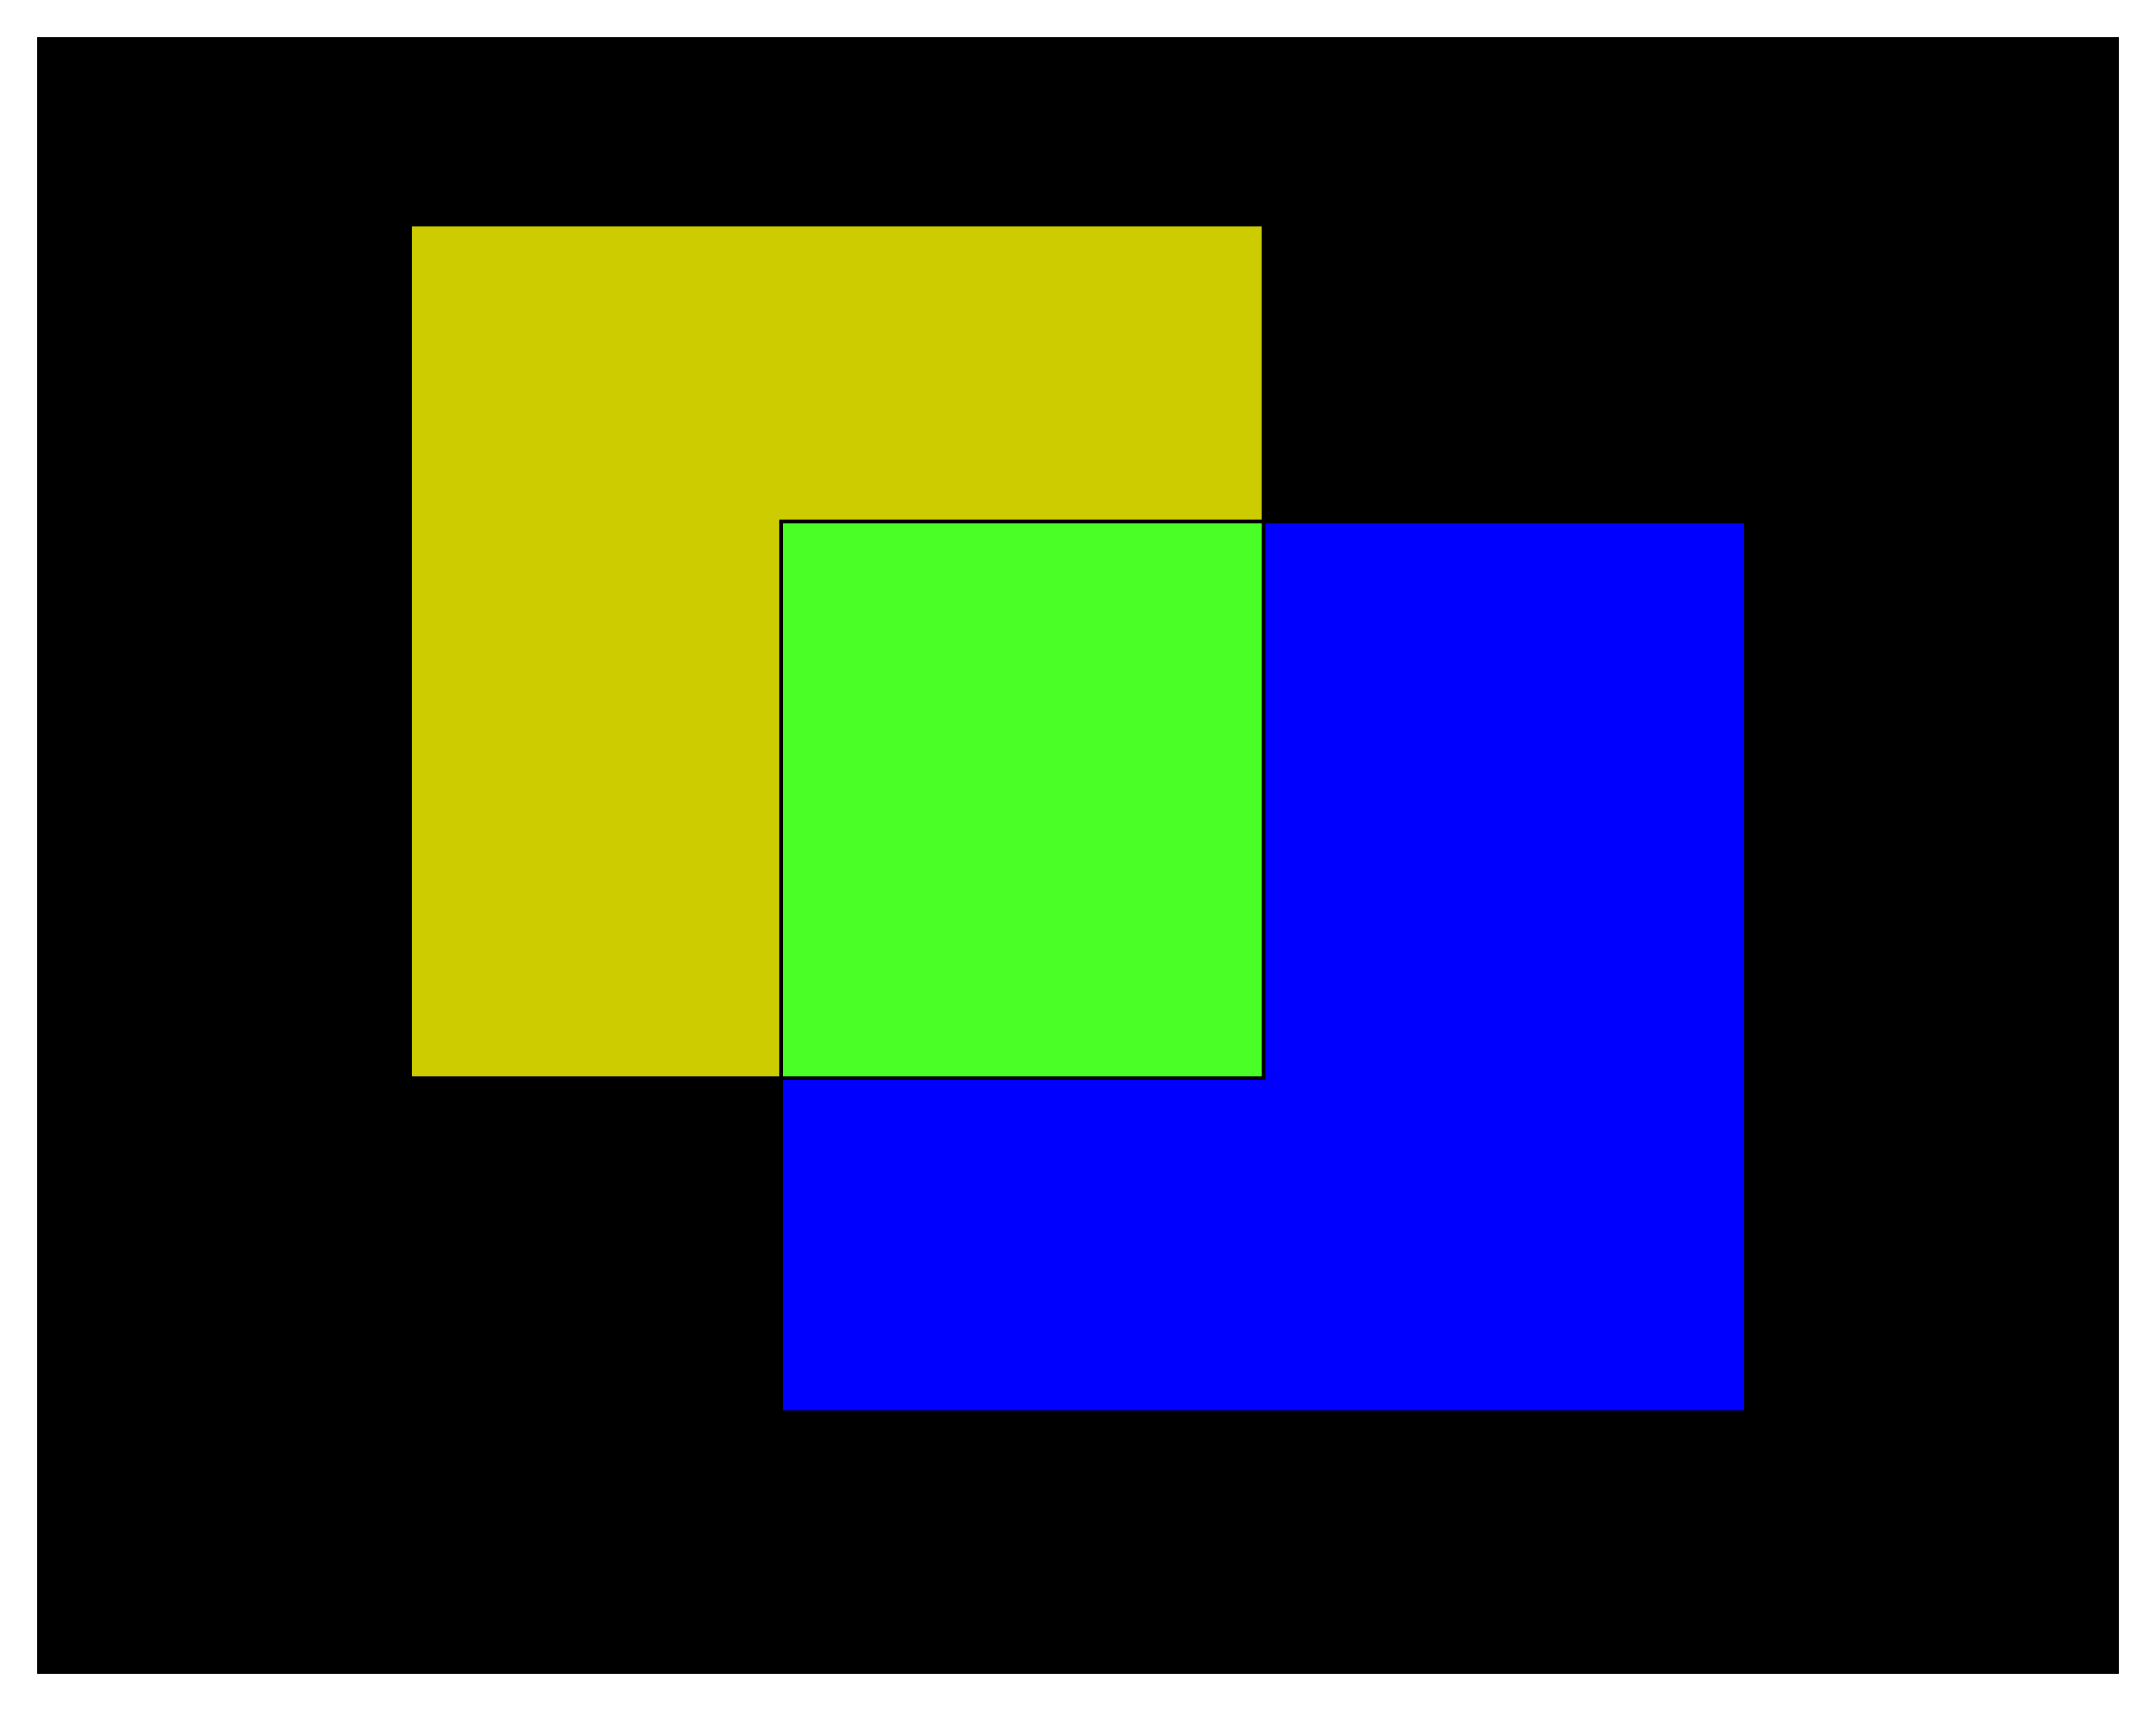
Quantify image segmentation results with bounding boxes
FN
TP
Assume that the yellow box is ground truth (actual foreground), while the blue box is the predicted foreground (segmentation result).
TN
FP

